Slide 1
Question To Ponder
How can we grant our computers the ability to see or hear?
Please sign-in: ucfai.org/signin

Slide 2
Convolutional Neural Networks
Concepts and Theory
Fall 2019

Slide 3
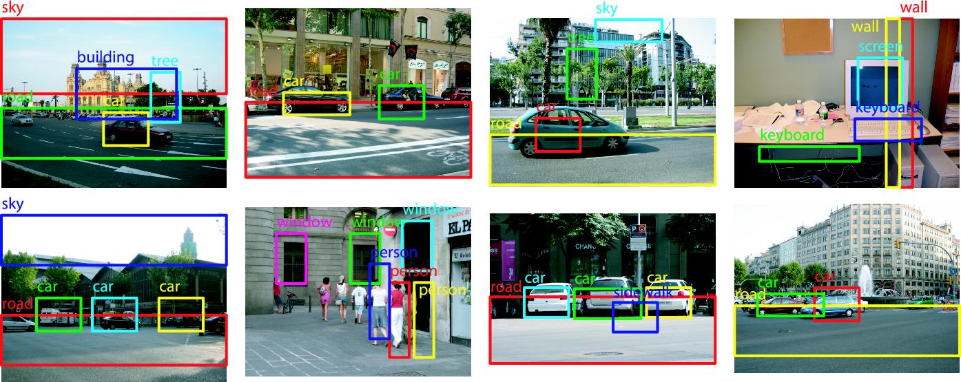
What kinds of problems can be solved using CNNs?
Due to the nature of CNNs they can applied to all kinds of unstructured data.
Audio data
Natural Language
Robotics
Computer Vision: Image Classification or Object Detection

Slide 4

So how exactly are features extracted?
The weights of a CNN consist of small filters, or kernels
These filters slide across the input, performing a dot product computation known as a convolution
The output of one convolution is an activation, and the entire matrix is a feature map

Slide 5
Convolutions at Scale
An example: http://setosa.io/ev/image-kernels/
Gradient Descent is used to find optimal values in each filter
The goal is to have certain features extracted and use them to predict the class of input

Slide 6
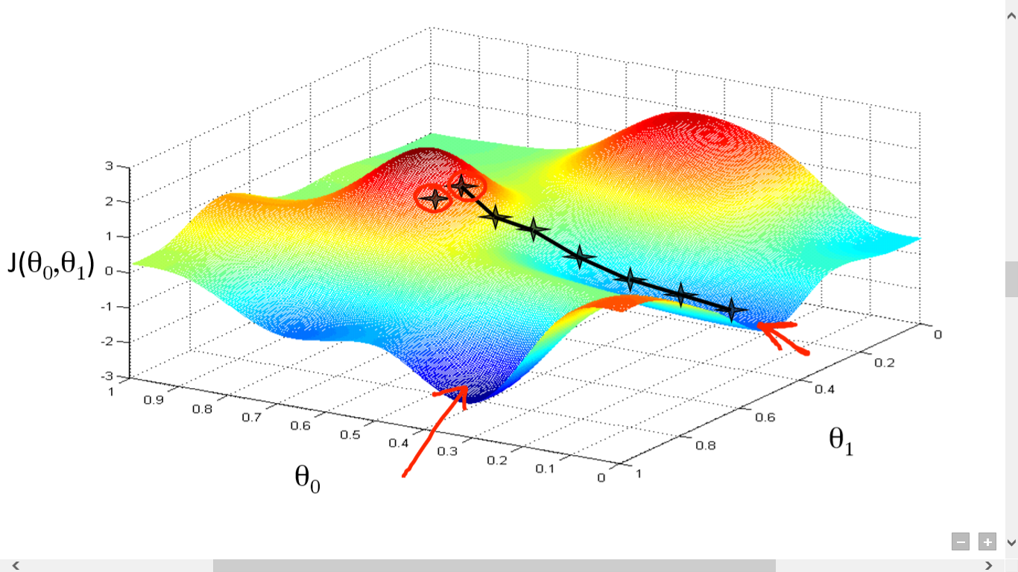

Gradient Descent Refresher
We “step down” the loss landscape, in the direction of the gradient, to find a minimum
To do this, we subtract the derivative (with respect to the loss function) of each weight, multiplied by a learning rate

Slide 7
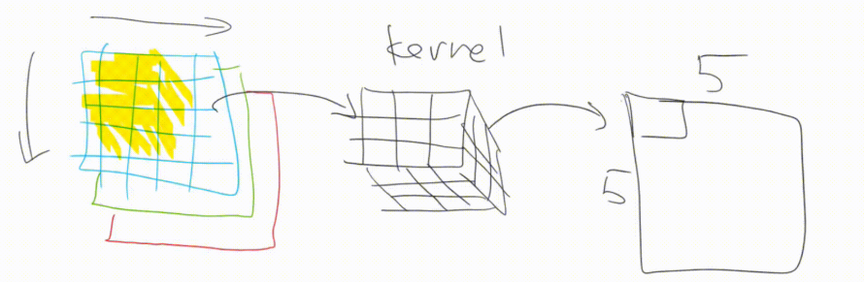
Convolutions in Practice
Most images are colored, and have 3 channels (red, green, and blue)
The initial filters then, must also be 3 channels deep
One convolution is now the dot product of 27 values (3 x 3 x 3)
The outputted feature map is still one channel deep

Slide 8
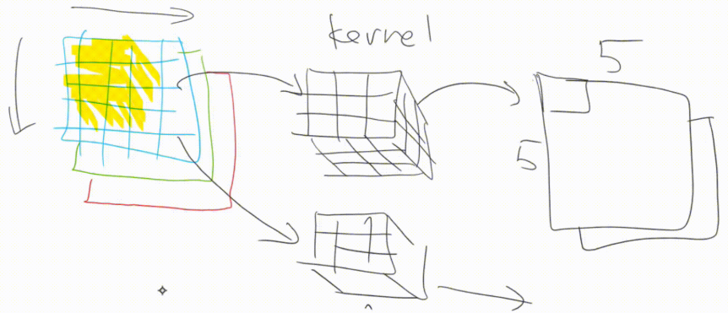
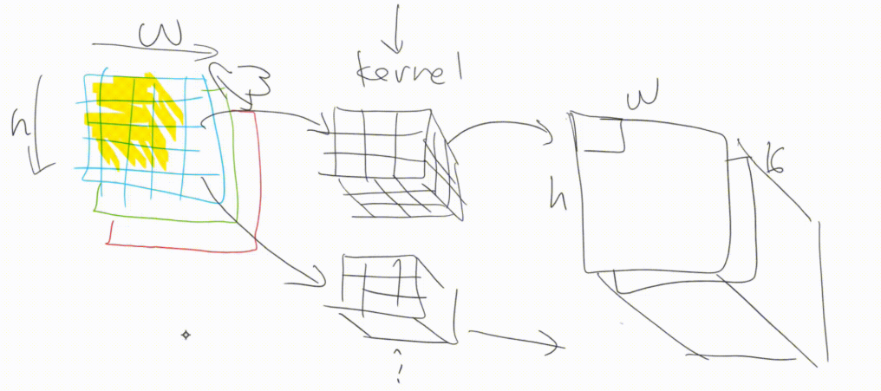
Extracting Additional Features
Applying different filters allows us to extract more features
Resulting 2-d feature maps stack to create a multi channel output
Each channel in the output essentially represents a different feature
This process makes up one convolutional layer

Slide 9
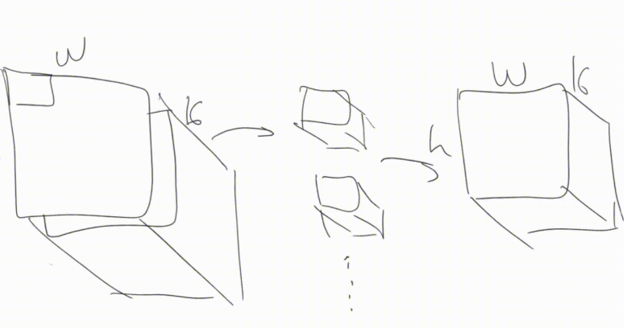
Adding Complexity
Following layer performs 3-dimensional convolutions on all of these features maps simultaneously
Allows the model to extract increasingly complex features
Channels in each kernel need to match the previous layer’s output

Slide 10
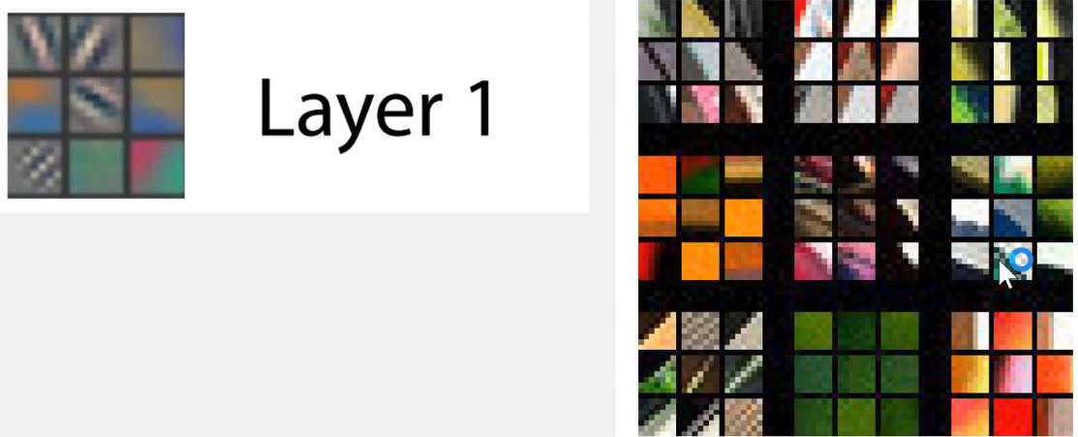
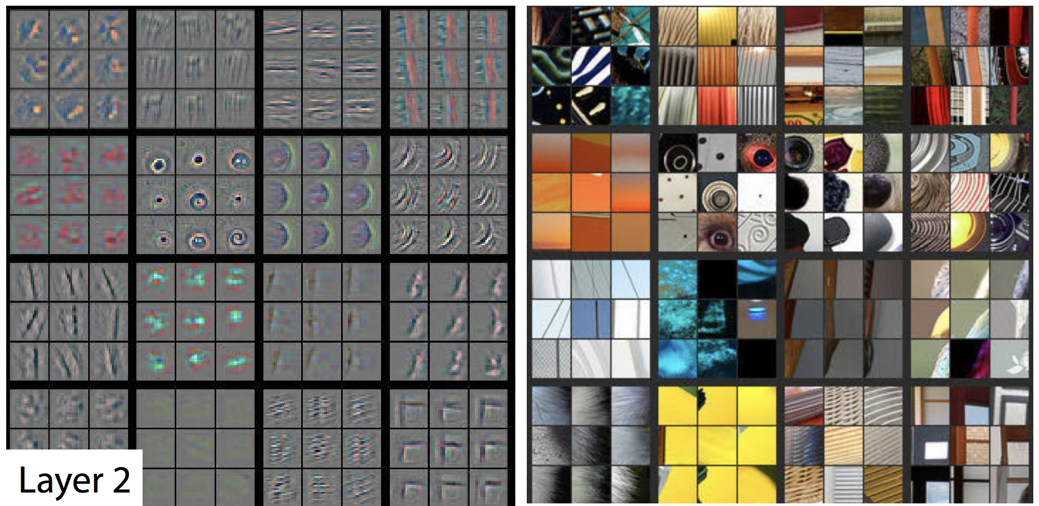
Visualizing CNN Layers
In general, filters in earlier layers extract simple shapes or gradients
Layer 2 takes the results of those filters and learns slightly more complex filters. Here we see some that look for top left corners, or right-hand curves, circles, etc.
Layer 1’s filters seem to extract diagonal lines, or different color gradients, etc.

Slide 11
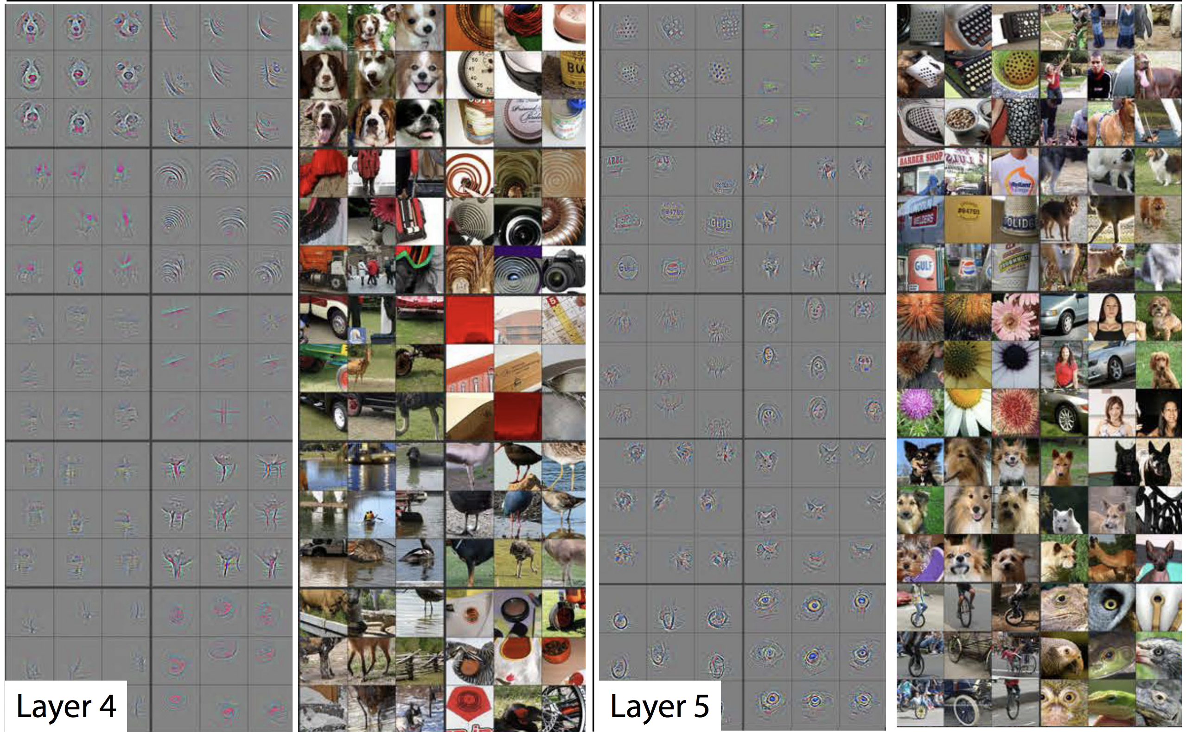
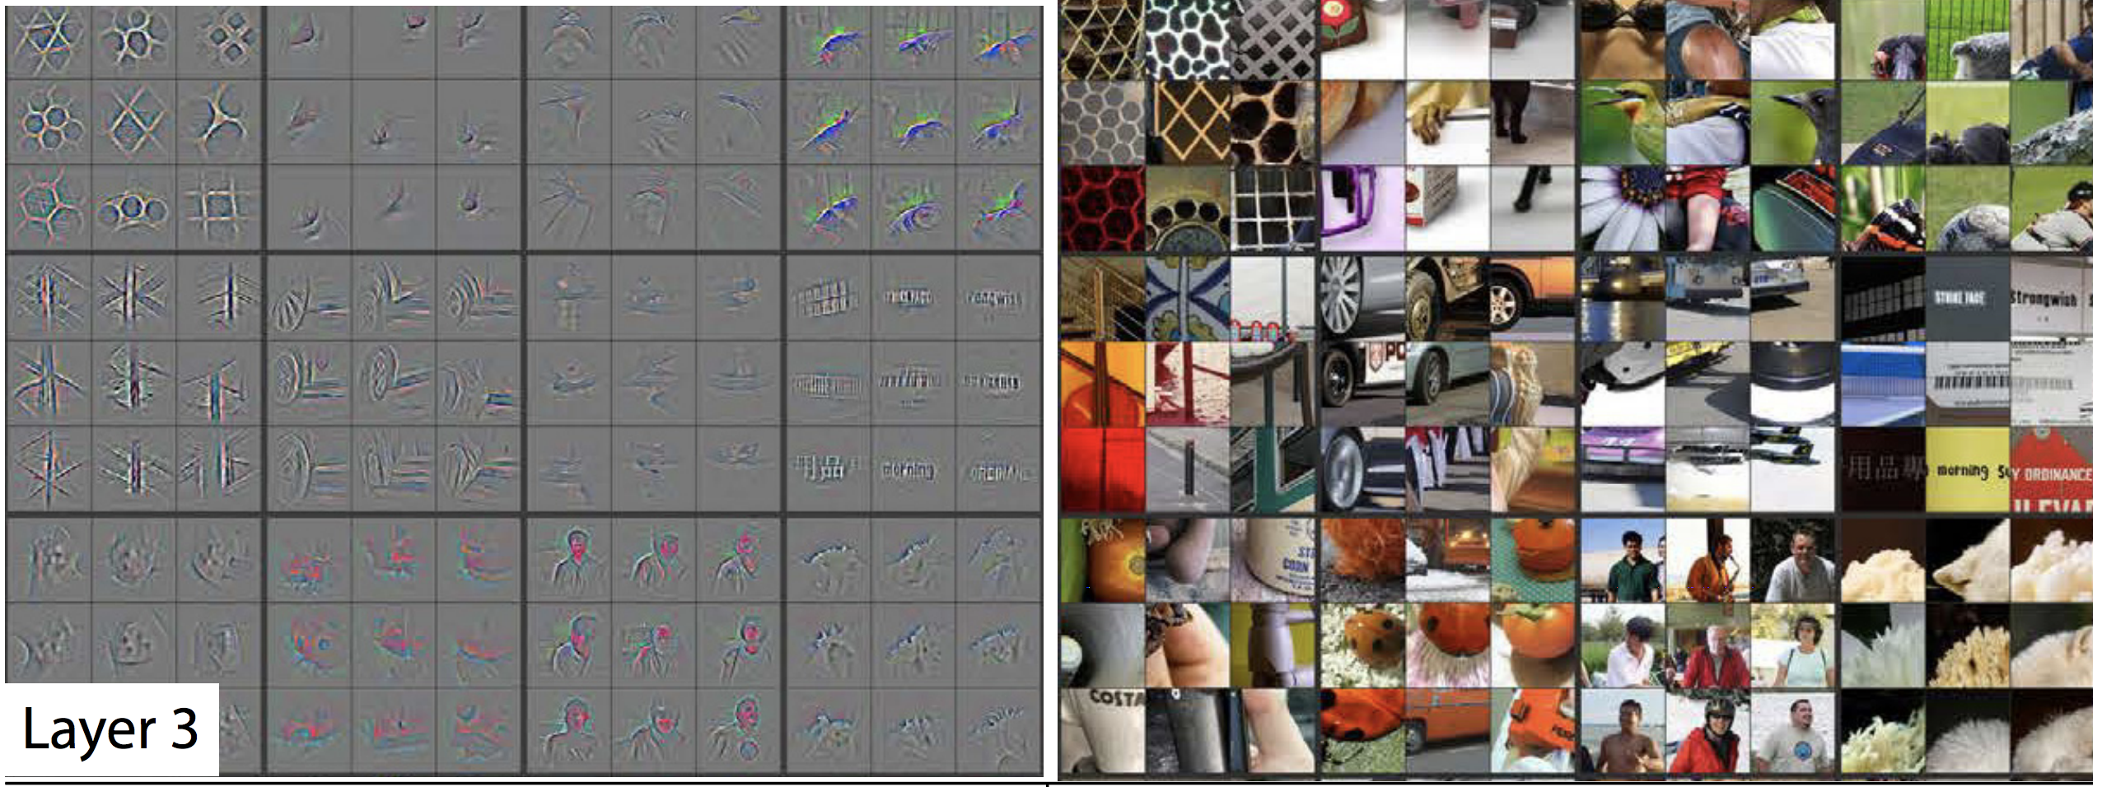
Visualizing CNN Layers
With this approach of stacking increasingly complex features, with only a few layers we can extract quite rich features from an image
At this point the model seems to be able to find two dimensional objects, bits of text, and geometric patterns which begin to resemble every day objects/images.
By layer 4 we can find generic dog faces, bird legs, bodies of water, and other bits of objects. And by layer 5, we've got filters that can find the eyeballs of animals , or faces of particular dog breeds…

Slide 12
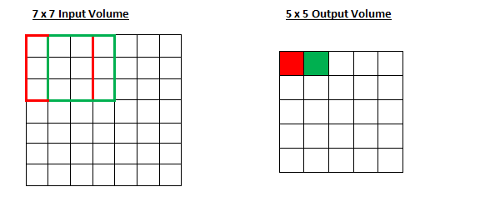
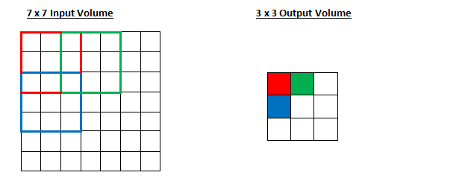
Additional Details
Stride: the number of pixels skipped after each convolution
Larger strides reduce the dimensions of the layer's output and computation required
A smaller stride captures finer details and relationships between nearby pixels in an input.

Slide 13
Additional Details
Padding: Where we pad the input, so the filter fits properly into the matrix after 'sliding' it across
Zero Padding: pads the input matrix with zeros
Valid Padding: drops the part of the input where the filter didn’t fit
Reflective Padding: pads outer edges with their reflections

Slide 14
What about an Activation Function?
Every convolutional layer should be followed by a nonlinearity
This is what allows our model to approximate relationships behind data, as described in the Universal Approximation Theorem
Introducing the commonly used Rectified Linear Unit (ReLU)
Replaces every negative value in a feature map with 0
Output = Max(0, Input)
In practice, a ReLU will follow every convolutional layer in a CNN

Slide 15
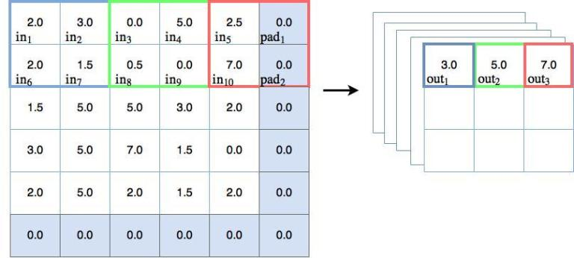
Pooling Layers
Applies a statistical function to the contents of a sliding window
Down Sampling reduces the size of its input and the total parameters
Enables the model to generalize across varying orientations or scales
Max Pooling
Average Pooling
Global Pooling
Etc.

Slide 16
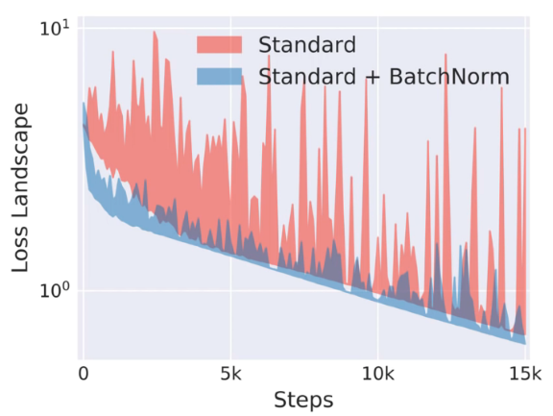
More Regularization Techniques
Dropout Layer: drops a percentage of activations in a layer by setting them to 0
Great way to easily reduce overfitting
Batch Normalization: normalizes a feature map so that all the activations in the layer have a mean of 0 and a variance of 1
Stabilizes the learning process and reduces the time needed to train a network

Slide 17
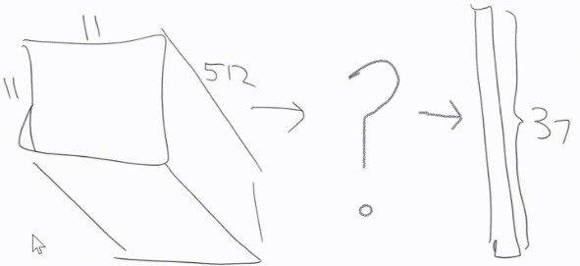
The Classification Block
So far, we’ve only discussed the feature extraction portion of a CNN
However, the end goal of a CNN is to use these extracted features to then predict the class of the input

Slide 18
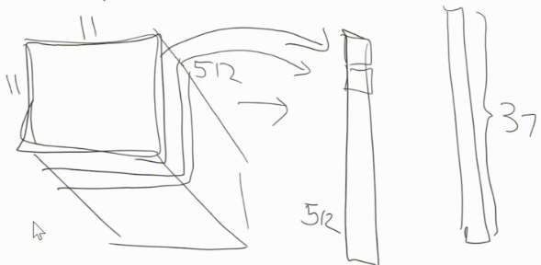
The Classification Block
An efficient way to turn this 3-d output of feature maps into a 2-d array of predictions is to apply a Global Average Pooling layer
A GAP layer averages all the activations in each of the feature maps

Slide 19
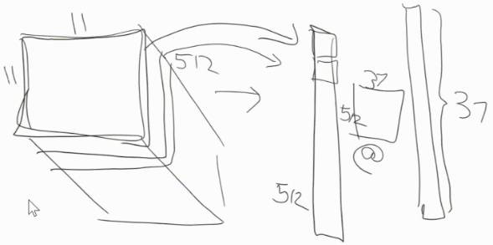
The Classification Block
The output of the GAP layer is fed through a fully connected layer, creating an array of length equal to the number of possible classes
Remember, a FC layer is essentially just a matrix multiplication

Slide 20
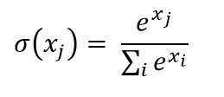

Final Activation Functions
An activation function is applied to create the final prediction array
Softmax: Creates a probability distribution where each value is positive and adds to 1.
Commonly used in single-label classification
Sigmoid: Values will still be between 0 and 1, however, they will not add to 1
Suitable for multi-label classification

Slide 21

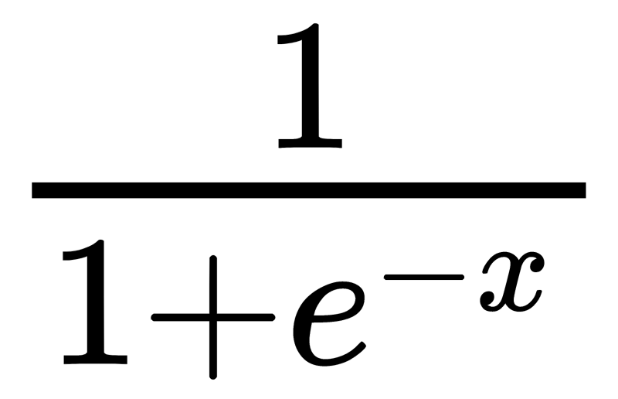
CNNs as a Whole
Use filters and convolutions to activate features found in input data
Then the extracted feature maps are used to compute how likely the input is to be each of the possible classes

Slide 23
Let’s look at how to build a CNN in PyTorch!

